Slide 1

Retrieval Augmented Generation with Vector Databases
Chandana Sapparapu
ML Engineer

Slide 2
LLMs are not enough
Frozen in time
Retraining and MLOps - unnecessary complexity
Not enterprise-specific

Slide 3
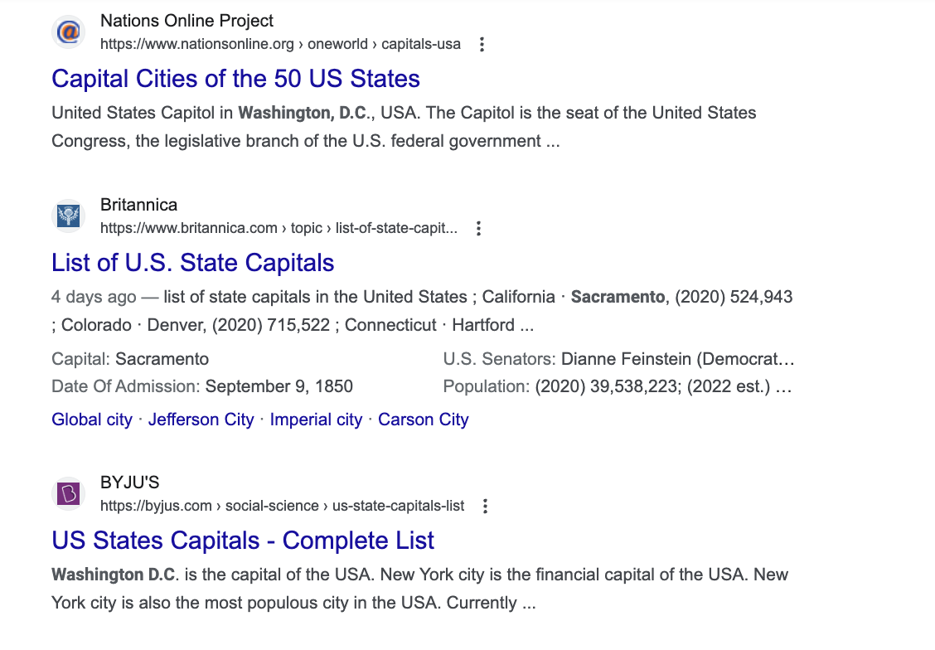
Keyword Search What is the capital of United States?

Slide 4
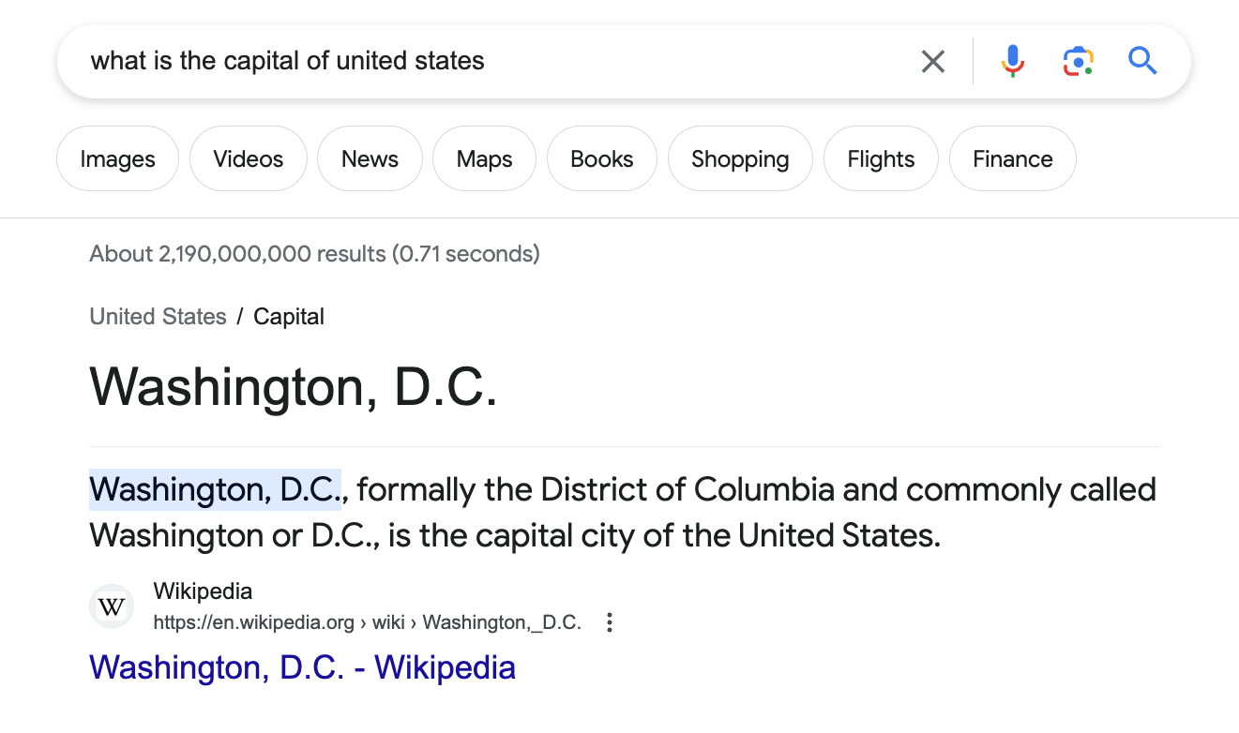
Semantic Search

Slide 5
Semantic Search
Search by meaning, not by keywords
Position of words considered
Visa to travel from US to Europe
Visa to travel from Europe to US

Slide 6
Embeddings what is the capital of united states
array([ 1.05454981e-01, -8.67220163e-02, -4.85465005e-02, 2.46116631e-02, -4.89532277e-02, -2.91991755e-02, 9.85017861e-04, -2.03903746e-02, -9.94820613e-03, -1.23988576e-02, -4.43419702e-02, -2.40106266e-02, 1.63478516e-02, -6.47824779e-02, -1.27610676e-02, -1.66669115e-02, 3.58685590e-02, -1.85415093e-02, 6.12014569e-02, 1.73998587e-02, 3.28328907e-02, -3.41951777e-03, -4.84048277e-02, -1.91735048e-02, 2.83702742e-02, 4.70312722e-02, 4.30993624e-02, -4.86529293e-03, -3.23459841e-02, -3.70373577e-02, 1.72070134e-02, -1.62528947e-01, 6.03489578e-02, 3.77740599e-02, -2.06367821e-02, -2.27741664e-03, 7.92960748e-02, 8.46523046e-03, 1.20928764e-01, 5.10835671e-04, 1.36688014e-03, 2.95177959e-02, -5.06901741e-03, 6.00136183e-02, -4.51465547e-02, 6.03538863e-02, -4.39183693e-03, 4.72531766e-02, 3.62087116e-02, 5.25857601e-03, 5.84313795e-02, 3.87197956e-02, -4.99499366e-02, 9.57472399e-02, -3.51600274e-02, 7.80392215e-02, 4.44279127e-02, -4.62502427e-03, 8.62468500e-03, -4.84910011e-02, -3.87090594e-02, -5.81044285e-03, 9.17773917e-02, 1.08033819e-02, 7.07090497e-02, -1.84188355e-02, 5.86450733e-02, -3.36022228e-02, -4.51733498e-03, -9.02460329e-03, 6.11258149e-02, 5.13481721e-02, -4.45142202e-02, -3.50371860e-02, 2.78081503e-02, -1.05961166e-01, -7.13118687e-02, 1.10636577e-01, 4.37044203e-02, 1.38284534e-01, 6.63037822e-02, -4.19320203e-02, -2.59421356e-02, 3.89300920e-02, -2.66515873e-02, -3.52995284e-02, -9.57147628e-02, 8.67917668e-03, -2.37676827e-03, -9.19831842e-02, -4.74888012e-02, 1.82183664e-02, 3.45501862e-02, -3.19862776e-02, -6.63288310e-02, -1.08854957e-02, -6.75847903e-02, 4.31097113e-02, -5.06680720e-02, -2.06239726e-02,...
1.15815878e-01, -5.23942821e-02, -6.37912825e-02, -7.04680458e-02, -2.12307158e-03, -6.49824888e-02, 1.33356098e-02, 8.84367898e-02, -7.68445358e-02, -4.76889871e-02, 6.71728626e-02, -3.51953916e-02, 1.26389042e-03, 3.21480371e-02, 1.82020571e-02, 2.43364312e-02], dtype=float32)

Slide 7
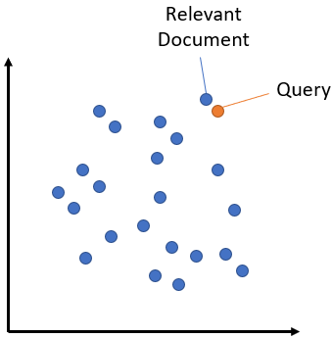
Retrieval from text embeddings

Slide 10
Searching embeddings
Libraries
FAISS
Annoy
ScaNN
Vector Databases
Milvus
Pinecone
Weaviate

Slide 11


Slide 12
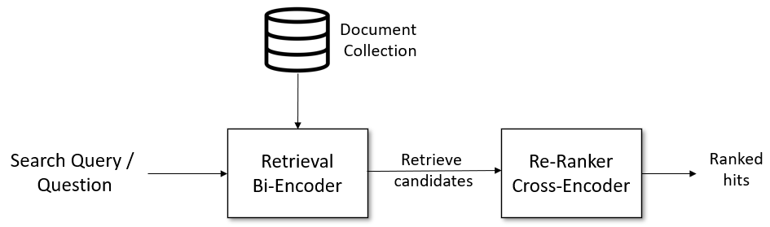
Searching a Vector Database

Slide 13
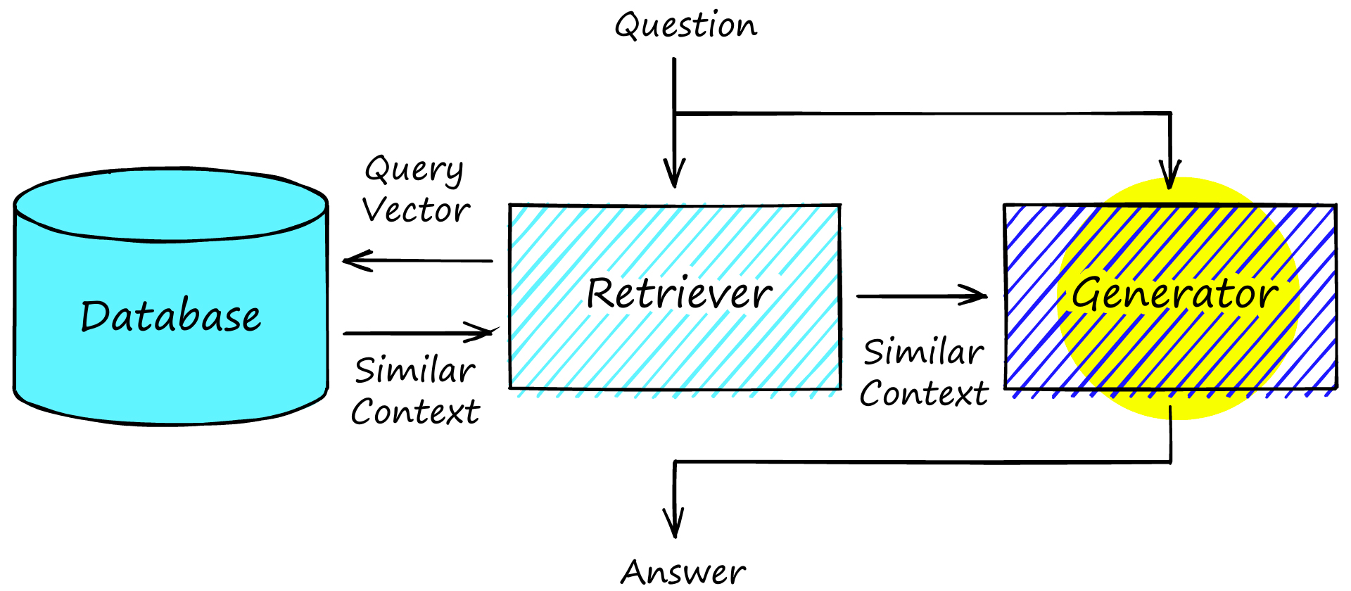
Answer Generation

Slide 14
References
https://learn.deeplearning.ai/large-language-models-semantic-search/
https://github.com/towhee-io/examples/blob/main/nlp/question_answering/1_build_question_answering_engine.ipynb
https://www.pinecone.io/learn/series/nlp/sentence-embeddings/
https://www.pinecone.io/learn/series/nlp/question-answering/

